Slide 1


Software testing
Συγχρονεσ τεχνολογιεσ προγραμματισμου: java & SPRING
Vasilis Petrou
Test Automation Architect

Slide 2

About me
Test Automation Architect and Consultant at Netcompany-Intrasoft
17 years Experience in Software Development and Test Automation
Co-organizer of Thessaloniki Software Testing & QA Meetup
Test Automation Instructor in Universities & Institutions
14-15/06/2022 Vasilis petrou | kedivim | university of maCedonia

Slide 3
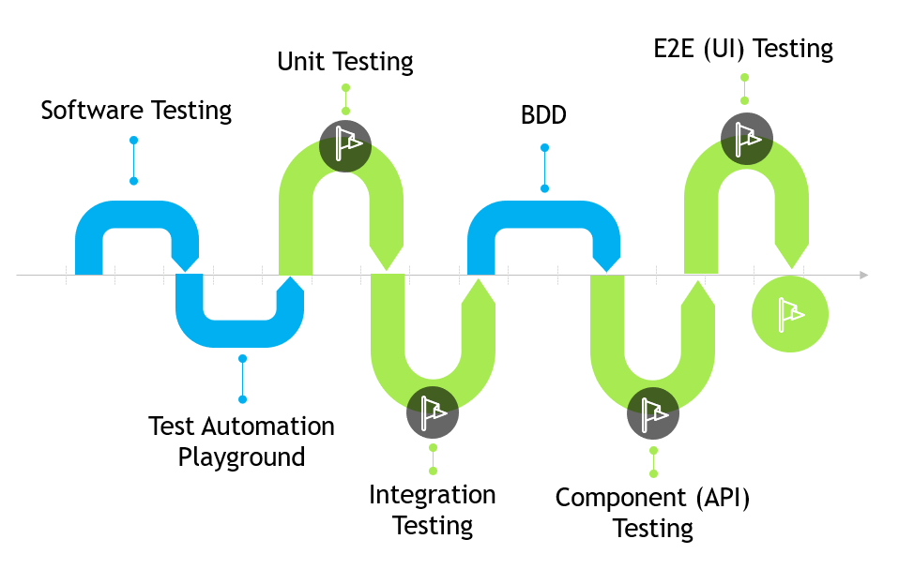
Roadmap
14-15/06/2022 Vasilis petrou | kedivim | university of maCedonia
14-15/06/2022 Vasilis petrou | kedivim | university of maCedonia

Slide 4

Software Testing
14-15/06/2022 Vasilis petrou | kedivim | university of maCedonia

Slide 5

Software Testing
Software testing is a process in Software Development Lifecycle (SDLC), where we check whether the actual results of a software match the expected results.

Slide 6
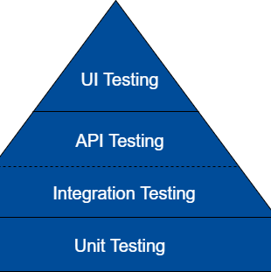
Testing Pyramid

Slide 7
TEST AUTOMATION PLAYGROUND
14-15/06/2022 Vasilis petrou | kedivim | university of maCedonia

Slide 8

To practice on software testing we need an application installed in our machine.
Let’s call it Test Automation Playground.
It is an indicative application for which we will create several types of tests.
So, let’s install the Test Automation Playground to start testing.

Slide 9
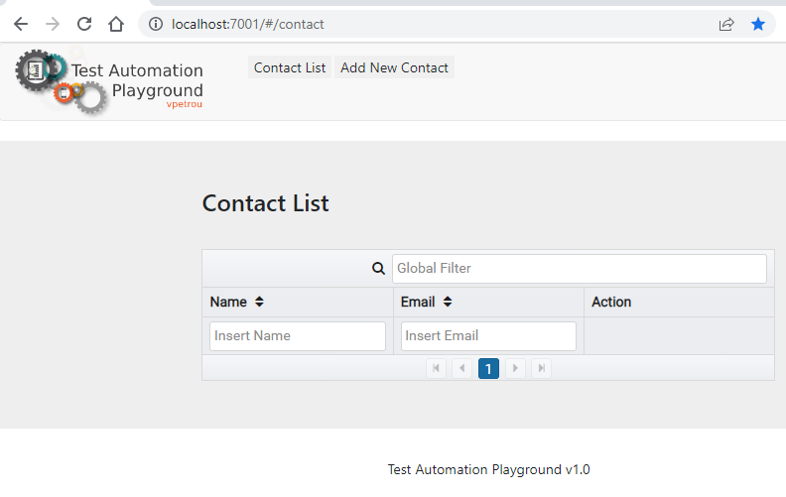
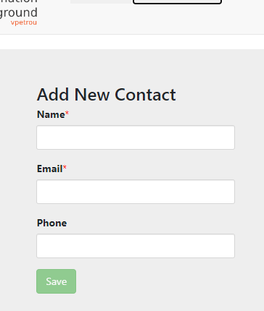
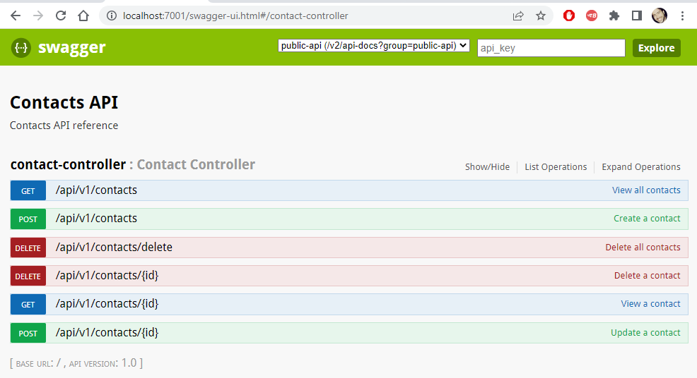
https://github.com/vpetrou/uom-test-automation-v2
Test Automation Playground is a DEMO Web application with CRUD (Create Retrieve Update Delete) operations built with Java Spring Boot and Angular.
It contains a User Interface (UI) environment, and a REST API.
Repository contains a README file with clear guidelines on how to install and run the Test Automation Playground.

Slide 10
UNIT Testing
14-15/06/2022 Vasilis petrou | kedivim | university of maCedonia

Slide 11

Developer Testing is an important step towards accountability. It gives developers a way to demonstrate the quality of the software they produce.
Kent Beck

Slide 12

Unit Testing
Unit testing is a type of automated testing meant to verify whether a small and isolated piece of the codebase—the so-called “unit”—behaves as the developer intended.

Slide 13

Unit Tests Implemented by…
The Developer that implements the related source code.

Slide 14
Not a Unit Test, when…
It talks to the database
It communicates across the network
It touches the file system
It cannot run in parallel with other unit tests
It needs special environment configuration to run
It loads the Spring context (when using Spring)
14-15/06/2022 VASILIS PETROU | KEDIVIM | UNIVERSITY OF MACEDONIA

Slide 15
Unit Test Best Practices
A unit test must be fast.
A unit test must be deterministic. If it’s failing, it has to continue to fail until someone fix the code under test.
A unit test must not be depended on external dependencies. Mocks can be used for that purpose.
A unit test must cover a specific portion of the code giving a super precise feedback.
14-15/06/2022 VASILIS PETROU | KEDIVIM | UNIVERSITY OF MACEDONIA

Slide 16
Unit Test Tools
JUnit5
Mockito
MockMvc (Spring Test)
Maven Surefire Plugin
https://github.com/vpetrou/uom-test-automation-v2/tree/feature-unit-tests
14-15/06/2022 VASILIS PETROU | KEDIVIM | UNIVERSITY OF MACEDONIA

Slide 17
INTEGRATION Testing
14-15/06/2022 Vasilis petrou | kedivim | university of makedonia

Slide 18

Integration Testing
Integration testing is a type of automated testing meant to verify whether different modules are bounded correctly and if they work as expected.

Slide 19

Integration Tests Implemented by…
Who is responsible depends on the team. But Developers are usually the ones who are responsible for writing and maintaining integration tests.

Slide 20
Integration Testing Approaches
Big Bang: All methods/units combined and tested into a single step.
Top-Down: Top-level functions/modules/units tested first.
Bottom-Up: Bottom level functions/modules/units tested first.
Sandwich (or Hybrid): Combination of Top-Down/Bottom-up.
14-15/06/2022 VASILIS PETROU | KEDIVIM | UNIVERSITY OF MACEDONIA

Slide 21
Integration Test Best Practices
An integration test must be executed as early and as often as possible, once unit test is complete.
An integration test must not test business logic
An integration test must not utilize the actual production dependencies (e.g., database/network etc.).
An integration test must use in-memory database for mimicking the database.
An integration test must use the Spring context (when using Spring)
14-15/06/2022 VASILIS PETROU | KEDIVIM | UNIVERSITY OF MACEDONIA

Slide 22
Integration Test Tools
JUnit5
Spring Test
AssertJ
Maven Failsafe Plugin
Jacoco (Code Coverage)
https://github.com/vpetrou/uom-test-automation-v2/tree/feature-integration-tests
14-15/06/2022 VASILIS PETROU | KEDIVIM | UNIVERSITY OF MACEDONIA

Slide 23
BDD Behavior-driven development
14-15/06/2022 Vasilis petrou | kedivim | university of makedonia

Slide 24

Behaviour-Driven Development
Behavior Driven Development (BDD) is a methodology for developing software through continuous example-based communication between developers, QAs and BAs.
The primary purpose of BDD methodology is to improve communication amongst the stakeholders of the project so that each feature is correctly understood by all members of the team before development process starts.
This helps to identify key scenarios for each story and also to eradicate ambiguities from requirements.
14-15/06/2022 VASILIS PETROU | KEDIVIM | UNIVERSITY OF MACEDONIA

Slide 25

Why Cucumber
Cucumber helps facilitate the discovery and use of a ubiquitous language within the team by giving the two sides of the linguistic divide a place where they can meet.
Cucumber tests interact directly with the developers’ code, but they’re written in a medium and language that business stakeholders can understand.
14-15/06/2022 VASILIS PETROU | KEDIVIM | UNIVERSITY OF MACEDONIA

Slide 26
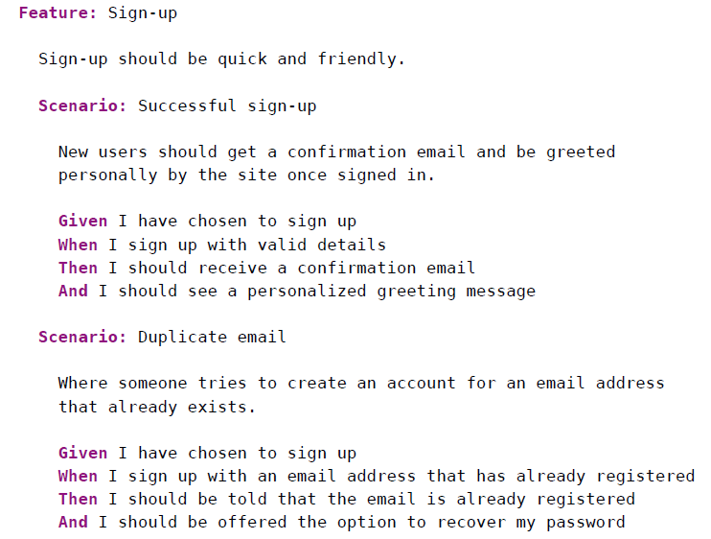
Example
14-15/06/2022 VASILIS PETROU | KEDIVIM | UNIVERSITY OF MACEDONIA

Slide 27
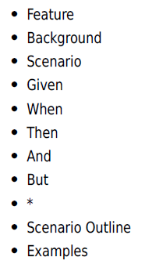
Format and Syntax
Gherkin files use the .feature file extension.
A Gherkin file is given its structure and meaning using a set of special keywords.
14-15/06/2022 VASILIS PETROU | KEDIVIM | UNIVERSITY OF MACEDONIA

Slide 28
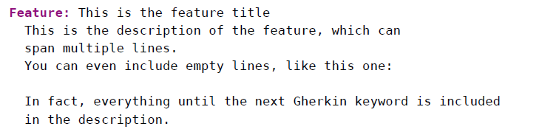
Feature
Each Gherkin file begins with the Feature keyword.
This keyword doesn’t really affect the behavior of your Cucumber tests at all; it just gives you a convenient place to put some summary documentation about the group of tests that follow.
14-15/06/2022 VASILIS PETROU | KEDIVIM | UNIVERSITY OF MACEDONIA

Slide 29
Scenario
To actually express the behavior we want, each feature contains several scenarios.
Each scenario is a single concrete example of how the system should behave in a particular situation.
If you add together the behavior defined by all of the scenarios, that’s the expected behavior of the feature itself.
When Cucumber runs a scenario, if the system behaves as described in the scenario, then the scenario will pass; if not, it will fail.
We use scenarios to explore edge cases and different paths through a feature.
14-15/06/2022 VASILIS PETROU | KEDIVIM | UNIVERSITY OF MACEDONIA

Slide 30
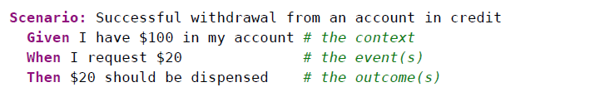
Given, When, Then
In Gherkin, we use the keywords Given, When, and Then to identify those three different parts of the scenario:
So, we use Given to set up the context where the scenario happens, When to interact with the system somehow, and Then to check that the outcome of that interaction was what we expected.
14-15/06/2022 VASILIS PETROU | KEDIVIM | UNIVERSITY OF MACEDONIA

Slide 31
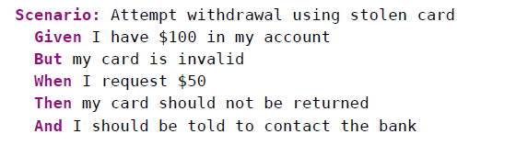
And, But
Each of the lines in a scenario is known as a step.
We can add more steps to each Given, When, or Then section of the scenario using the keywords And and But
14-15/06/2022 VASILIS PETROU | KEDIVIM | UNIVERSITY OF MACEDONIA

Slide 32
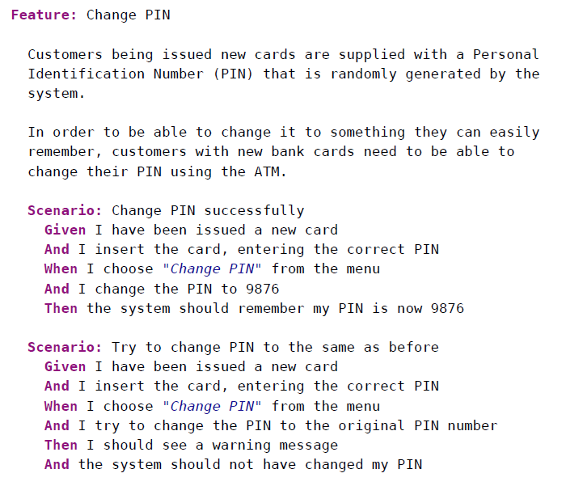
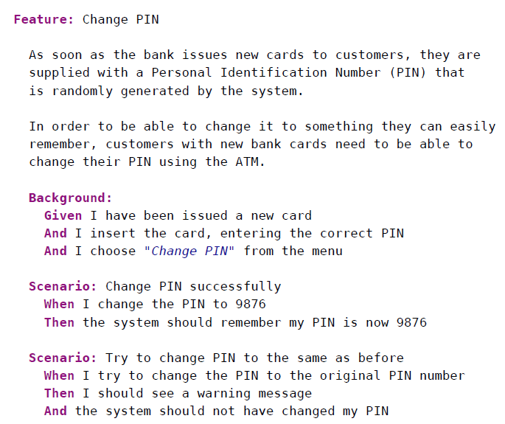
Background
A background section in a feature file allows you to specify a set of steps that are common to every scenario in the file.
14-15/06/2022 VASILIS PETROU | KEDIVIM | UNIVERSITY OF MACEDONIA

Slide 33
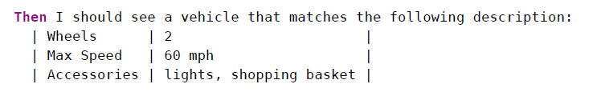
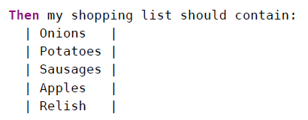
Data Tables
14-15/06/2022 VASILIS PETROU | KEDIVIM | UNIVERSITY OF MACEDONIA
πανεπιστημιο μακεδονιασ | Κεντρο επιμορφωσησ και δια βιου μαθησησ | βασιλησ πετρου | TEST AUTOMATION LEAD

Slide 34
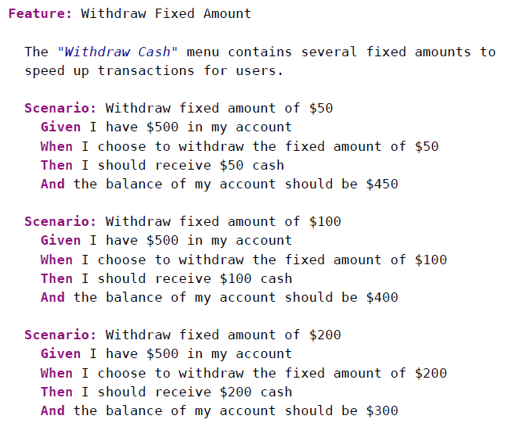
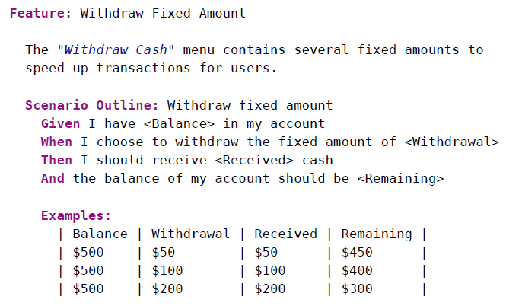
Scenario Outline
Sometimes we have several scenarios that follow exactly the same pattern of steps, just with different input values or expected outcomes.
14-15/06/2022 VASILIS PETROU | KEDIVIM | UNIVERSITY OF MACEDONIA

Slide 35
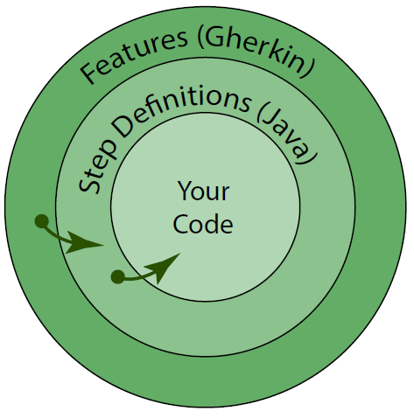
The main layers of a Cucumber test suite
We start with features, which contain our scenarios and steps.
The steps of our scenarios call step definitions that provide the link between the Gherkin features and the application being built.
14-15/06/2022 VASILIS PETROU | KEDIVIM | UNIVERSITY OF MACEDONIA

Slide 36
Maven Project Archetype
mvn archetype:generate -DarchetypeGroupId=io.cucumber -DarchetypeArtifactId=cucumber-archetype -DarchetypeVersion=5.6.0 -DgroupId=com.testing.bdd -DartifactId=demo -Dpackage=com.testing.bdd -Dversion=1.0.0 -DinteractiveMode=false
14-15/06/2022 VASILIS PETROU | KEDIVIM | UNIVERSITY OF MACEDONIA

Slide 37
BDD Tools
Cucumber
JUnit Vintage Engine
Cucumber Report
14-15/06/2022 VASILIS PETROU | KEDIVIM | UNIVERSITY OF MACEDONIA

Slide 38
API Testing
14-15/06/2022 Vasilis petrou | kedivim | university of makedonia

Slide 39

API Testing
API testing is a software testing type that validates Application Programming Interfaces (APIs). Because the API or service layer directly touches both the data layer and the presentation layer, it presents the sweet spot of continuous testing for QA and Development teams.

Slide 40

API Tests Implemented by…
Developers or Test Automation Engineers are usually the ones who are responsible for scripting, maintaining and automatically executing API Tests.
This Photo by Unknown Author is licensed under CC BY-ND

Slide 41
API Test Best Practices
API Tests must user realistic data
API Tests must contain positive and negative cases.
API Tests must not be repeatable
API Tests must be independent and capable to run in parallel.
14-15/06/2022 VASILIS PETROU | KEDIVIM | UNIVERSITY OF MACEDONIA

Slide 42
API Testing Tools
Rest Assured API
Google Guava
Maven Failsafe Plugin
https://github.com/vpetrou/uom-test-automation-v2/tree/feature-api-tests
14-15/06/2022 VASILIS PETROU | KEDIVIM | UNIVERSITY OF MACEDONIA

Slide 43
UI Testing
14-15/06/2022 Vasilis petrou | kedivim | university of makedonia

Slide 44

UI Testing
UI testing is a software testing type that checks the Graphical User Interface of the Software to ensure that the functionalities of software application work as per specifications by checking screens and controls like menus, buttons, icons, etc.

Slide 45

UI Tests Implemented by…
UI Test can be Manual or Automated
Developers are usually the ones who are doing some manual UI checks after finishing their implementation.
Testers are usually the ones who are responsible for writing and executing manually UI Tests.
Test Automation Engineers are usually the ones who are responsible for scripting, maintaining and automatically executing Automated UI Tests.

Slide 46
UI Test Best Practices
UI Tests must follow coding patterns and object-oriented programming principals (e.g., Page Object Pattern, Fluent Builder Pattern etc.).
UI Tests must be independent and capable to run in parallel.
UI Tests must be small and easily debugged (logs, assertions etc.).
UI Tests must follow a consistent naming convention.
14-15/06/2022 VASILIS PETROU | KEDIVIM | UNIVERSITY OF MACEDONIA

Slide 47
UI Testing Tools
Selenium WebDriver
https://github.com/vpetrou/uom-test-automation-v2/tree/feature-ui-tests
14-15/06/2022 VASILIS PETROU | KEDIVIM | UNIVERSITY OF MACEDONIA

Slide 48
LINKS
14-15/06/2022 Vasilis petrou | kedivim | university of makedonia

Slide 49
Links
JUnit5 https://junit.org/junit5
Mockito https://site.mockito.org
Spring Test https://docs.spring.io/spring-framework/docs/current/reference/html/testing.html
AssertJ https://assertj.github.io/doc/#assertj-core
TestContainers https://www.testcontainers.org
Cucumber BDD https://cucumber.io
REST Assured API http://rest-assured.io
Selenium WebDriver https://www.selenium.dev
ISTQB http://www.istqb.org
14-15/06/2022 VASILIS PETROU | KEDIVIM | UNIVERSITY OF MACEDONIA

Slide 50

Testing Principals & Certifications
ISTQB
International Software Testing Qualification Board
https://www.istqb.org

Slide 51




Where to find me?
https://github.com/vpetrou Test Automation Playgrounds to practice on GUI & API Automated Testing
https://www.linkedin.com/in/vpetrou
vpetrou@netcompany-intrasoft.com
vasilis.petrou@outlook.com.gr
https://www.meetup.com/Thessaloniki-Software-Testing-and-QA
14-15/06/2022 VASILIS PETROU | KEDIVIM | UNIVERSITY OF MACEDONIA

Slide 52



Quality is free, but only to those who are willing to pay heavily for it.
Tom DeMarco

Slide 53




Thank you
Vasilis Petrou
vasilis.petrou@outlook.com.gr
https://gr.linkedin.com/in/vpetrou

